Slide 1
Portugal as Reference Member State
Strategic Objectives
Sustainability of the Healthcare System
Market Surveillance and Risk Management
Development of Pharmaceutical and Health Products Sectors
Communication Strengthening
Continuous Improvement and Internal Efficiency
Strengthen the Positioning in the International Context

Slide 2
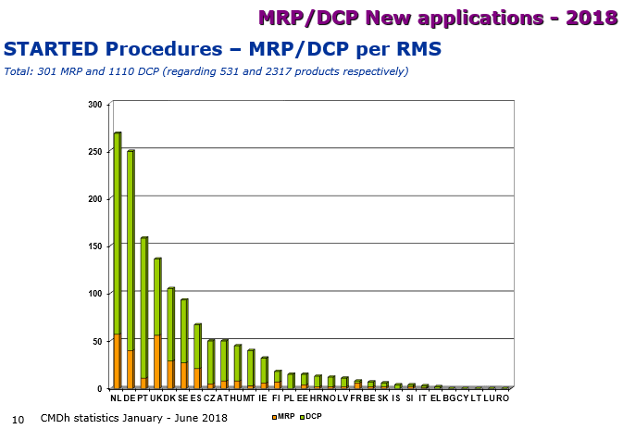
INFARMED´s Strategic Objectives
INFARMED in the European System
 | European Ranking | Started procedures
2007 | 14th | 13
2008 | 7th | 58
2009 | 6th | 74
2010 | 5th | 158
2011 | 4th | 239
2012 | 3rd | 226
2013 | 5th | 110
2014 | 4th | 153
2015 | 4th | 186
2016 | 4th | 161
2017 | 4th | 145
2018 | 3rd | 160
Portugal, 3rd MS that starts procedures as RMS
Souce: CMDh/HMA statistics
2018

